Slide 1
ML Applications in Network Operations & Security
Hazem Soliman, RANK Software Inc.

Slide 2
Speaker
BSc, MSc, Cairo University EECE
PhD, University of Toronto, ECE
3+ years industrial experience in network automation (operations and security)

Slide 3
Outline
Example use-cases in network operations and security.
Three Main applications.
  Ex 1: Detecting C2 Traffic.
  Ex 2: Incident Detection.
  Ex 3: IP Embedding.
Summary and Conclusion.

Slide 4
Target
Network Operations
Network Security
Who:
  NoC (Network Operations Centre)
  Service Providers, e.g. Vodafone
Goal: detect customer-impacting network problems, before customers complain
Who:
  SoC (Security Operations Centre), security analysts
  Enterprises, MSSP (Managed Security Service Provider)
Goal: Detect security breaches, prevent data theft

Slide 5
NoC (Network Operations Center)
Home Internet
BRAS
Agg
Agg
Core Router
Core Router
Edge
Edge
Provider B

Slide 6

Failure
Home Internet
A link is down, e.g. cable cut
Network status updates will show a down link/interface
Easy problem, to detect
BRAS
Agg
Agg
Core Router
Core Router
Edge
Edge
Provider B

Slide 7
Silent Failure
Congestion Build up
Home Internet
A misconfiguration is pushing majority to traffic to slower link
Link is congested, traffic is dropped, but network is Up
Silent failure, harder to detect
Anomaly Detection to identify abnormal traffic
BRAS
Agg
Agg
Core Router
Core Router
10 Gbps
100 Gbps
Edge
Edge
Provider B

Slide 8
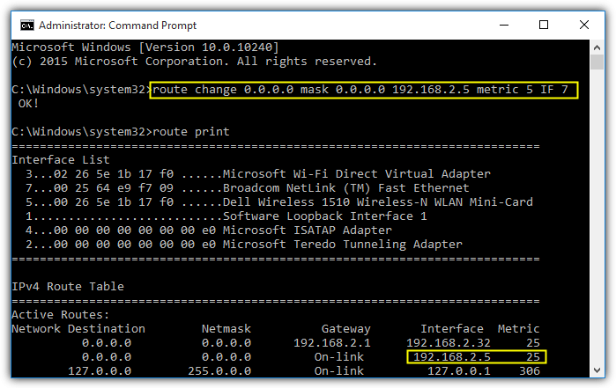
Silent Failure – Explain and Cause
Home Internet
BRAS
Detect Anomaly
Agg
Agg
Identify location of anomaly, device and link
Core Router
Core Router
Identify command responsible
10 Gbps
100 Gbps
Edge
Edge
Provider B

Slide 9
Failure
Home Internet
A link is down, e.g. cable cut
Network status updates will show a down link/interface
Easy problem, to detect
BRAS
Agg
Agg
Core Router
Core Router
Even for non-silent failures, time-to-detect is very important, 5 minutes vs 30 minutes
Detect before customers complain
Edge
Edge
Provider B

Slide 10
BGP Hijack
Home Internet
Misconfigured, or malicious, changes in internet routing tables.
Visible through traffic changes, BGP route updates and Syslog BGP commands.
BRAS
Agg
Agg
Core Router
Core Router
Edge
Edge
Edge
Provider B
Provider C

Slide 11
Possible Outcomes
A misconfiguration happened in Router X due to command Y by user Z at time T resulting in traffic shift to router A.
Anomaly at time T
Visualization of anomalies
Explain anomaly, e.g. affected features
Affected Devices
Potentially related Syslog commands
Similar Previous Anomalies

Slide 12




SoC (Security Operations Center)
Advanced Persistent Threats (APT)
IDS can identify some malicious behavior
IDS can’t detect lateral movement
Malware traffic is harder to detect with signatures, e.g. periodic
Anomaly Detection to identify abnormal lateral movement, and traffic with special characteristics, e.g. periodic
Malicious file downloaded
Intrusion Detection System
Switch
Malware spreads through the network
Internet Gateway
Malware communicates with the control server

Slide 13
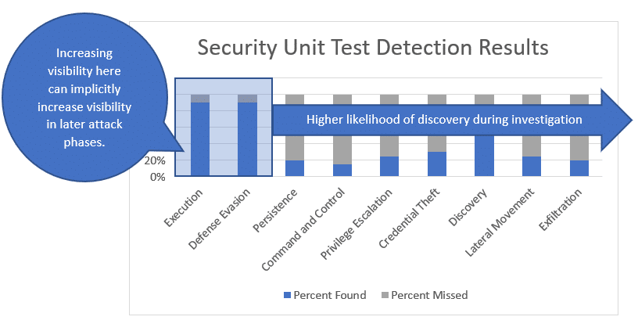
Mitre Att&ck & Cyber Kill-Chain
Use ML to help analyst with investigation
IDS alerts are overwhelming, high false positive
https://blog.netspi.com/prioritizing-the-remediation-of-mitre-attck-framework-gaps/

Slide 14
Incident Detection
Detect Abnormality in Traffic
Malicious file downloaded
Correlate (co-caused) anomalies together, look for other suspicious behavior (Build Incident)
Intrusion Detection System
Switch
Malware spreads through the network
Internet Gateway
Malware communicates with the control server
Incorporate analyst feedback

Slide 15
Possible Outcomes
Stuxnet
Potential data exfilteration at time T from user X, with score Z.
Preceded by anomalies … with scores … .
Score for each phase of the attack chain.
Potentially affected machines.
Similar previous anomalies.

Slide 16
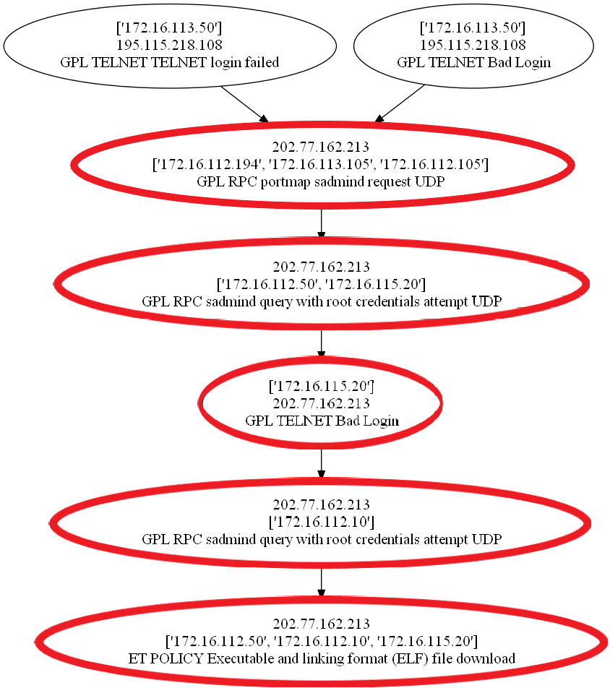
Example – DARPA dataset
Hazem Soliman, “An Optimization Approach to Graph Partitioning for
Detecting Persistent Attacks in Enterprise Networks”, to appear ISNCC 2020

Slide 17
Example Incidents
StuxNet (W32.Stuxnet Dossier, Symantec)
APT1, APT3 (APT1, Exposing One of China’s Cyber Espionage Units, Mandiant)

Slide 18
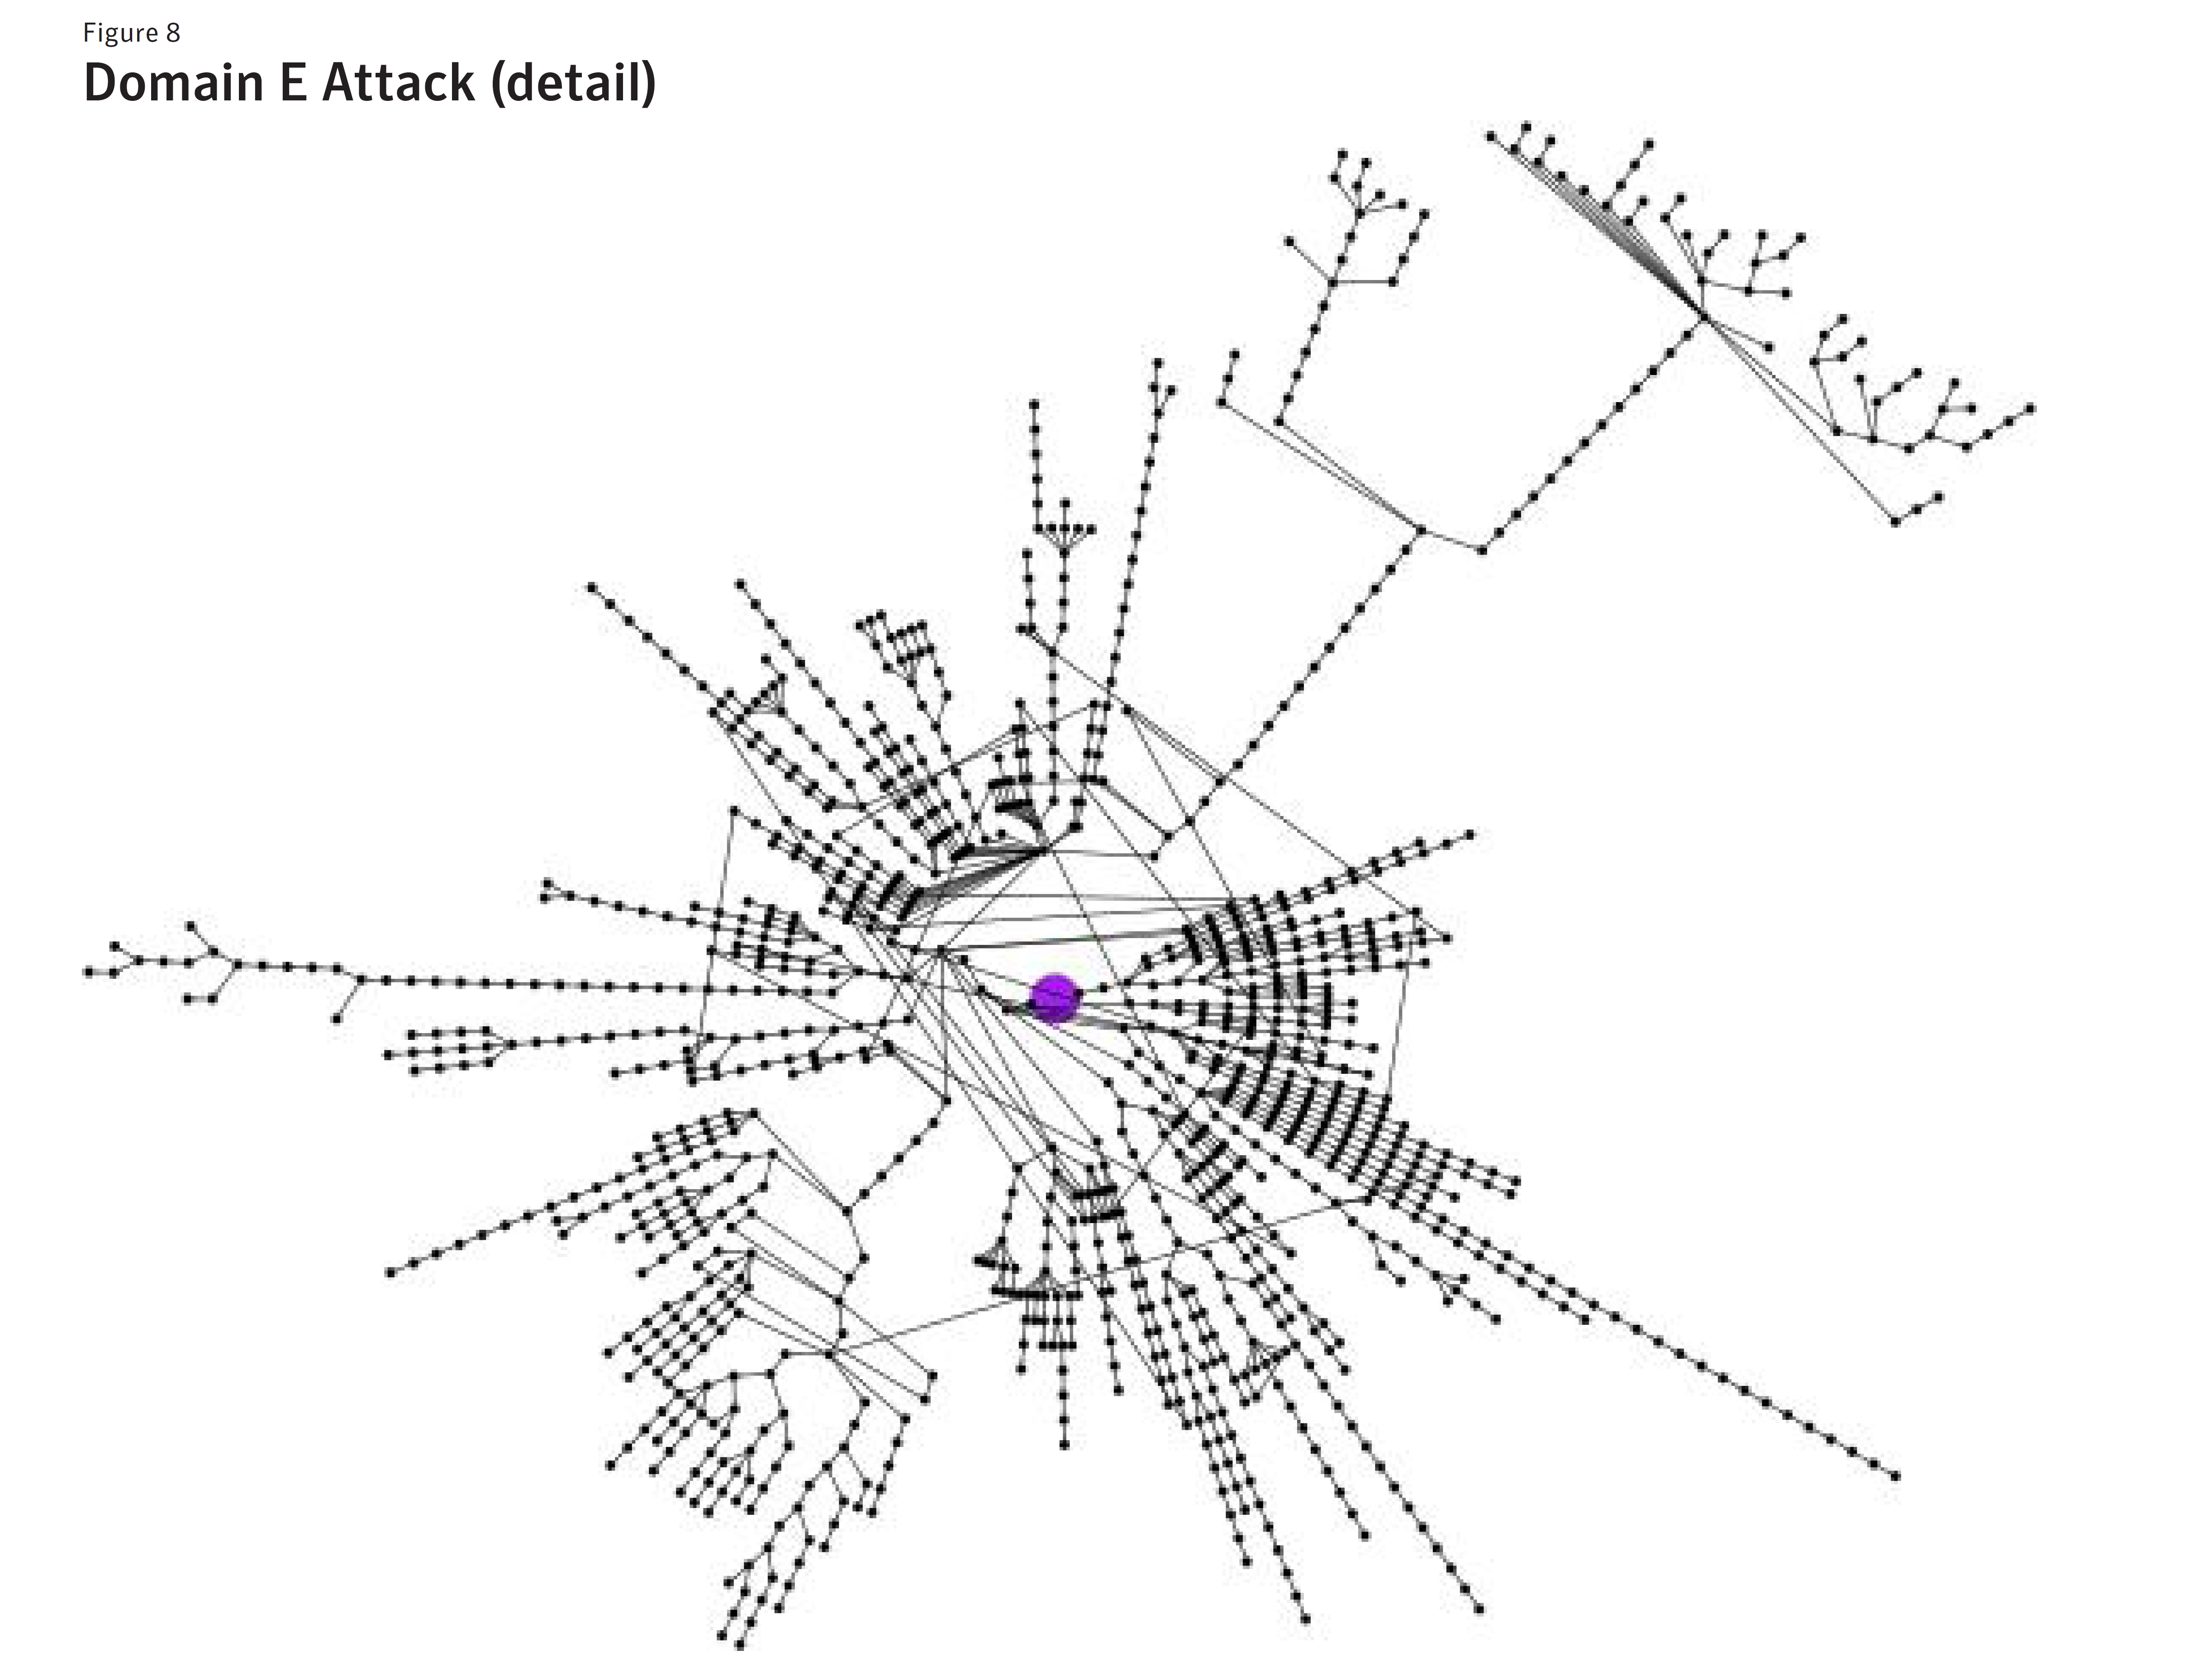
StuxNet

Slide 19
APT1

Slide 20
Summary
Anomaly Detection + Explanation
Root-Cause /
Incident Detection
User Interaction and Active Learning
Data Feeds
Data Feeds
Data Feeds

Slide 21
End Point Agents – Adversarial Machine Learning
How to decide if file is malicious ?
Active area in adversarial machine learning, generate new malware to enhance classifier robustness
Challenges:
  Generated malware must be a valid file, harder criteria compared to images
  Access to downloaded files, business decision !
Ex: Adversarial Perturbations Against Deep Neural Networks for Malware Classification
Ex: Cylance, I Kill You!
Malicious file downloaded
Intrusion Detection System
Switch
Internet Gateway

Slide 22
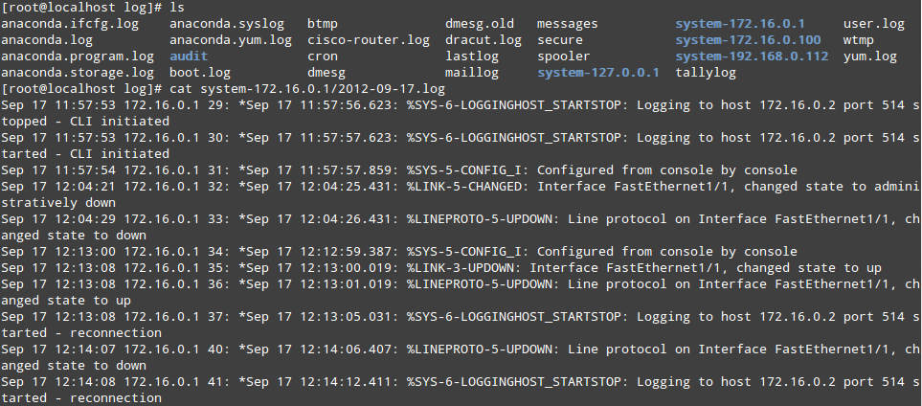
Typical System Setup
Home Internet
Date flow start Duration Proto Src IP Addr:Port Dst IP Addr:Port Packets Bytes Flows
2010-09-01 00:00:00.459 0.000 UDP 127.0.0.1:24920 -> 192.168.0.1:22126 1 46 1
2010-09-01 00:00:00.363 0.000 UDP 192.168.0.1:22126 -> 127.0.0.1:24920 1 80 1
NetFlow Collector
(Anomaly Detection)
BRAS
Agg
Agg
Syslog Collector
(Root-Cause Analysis)
Core Router
Core Router
Edge
Edge
Provider B
https://opentodo.wordpress.com/2012/09/17/syslog-centralized-logging/

Slide 23
Typical System Setup
Anomaly Detection
Explain
Deep Packet Inspection + Network Logs
Zeek
Incident Detection
Intrusion Detection System
Suricata
Sysmon logs
Switch
Internet Gateway

Slide 24
Domain Challenges
Very Scarce labels !,
  what should be labelled (e.g. TCP handshake packet)
Causality ?, very hard problem
Sensitive Data, can’t go outside
Intelligent human adversary, threats becoming more sophisticated
Huge amount of data
  Scalability
  Even a small false-positive is not acceptable (1% of 100 GB = 1 GB per day)

Slide 25
Examples
Anomaly Detection
Root-Cause /
Incident Detection
User Interaction and Active Learning
Data Feeds
Data Feeds
Data Feeds
Periodicity Detection
Factor Graphs
IP2Vec

Slide 26
Anomaly Detection ?!
Spatial Correlation | Feature Correlation | Temporal Correlation (Ops) | Temporal Correlation+
BRAS(s) should follow the same traffic pattern. Users, within a subnet, should follow same traffic pattern. Techniques: PCA, R-PCA, Auto-encoders | Uplink-downlink traffic is correlated Flow count, bytes, packets, ports, IPs correlated Large number of ports for small number of Ips -> scanning Large number of small-sized packets -> Brute-force Techniques: Isolation Forest, OC-SVM | Traffic in successive time-instants should be similar. Techniques: Holt-Winters, ARIMA, Kalman filter, Sequence Models | Periodic Traffic is suspicious. Techniques: Fourier transform.

Slide 27
Anomaly Detection Steps
Normalization
Ex: PCA expects Gaussian,
AE expects i.i.d
Depends on domain-knowledge (e.g. traffic models), and ML-knowledge (expected input distribution)
Feature Extraction ?
Anomaly Detection
Anomaly Explanation

Slide 28
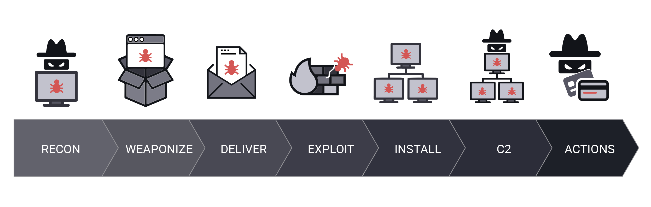
Periodicity Detection for C2 Traffic

Slide 29
C2 Detections
IP Blocklists
Domain Blocklists
File Hashes
Dynamic DNS registrars
Machine Learning/Analytics based approaches (Detect Periodic Traffic)

Slide 30
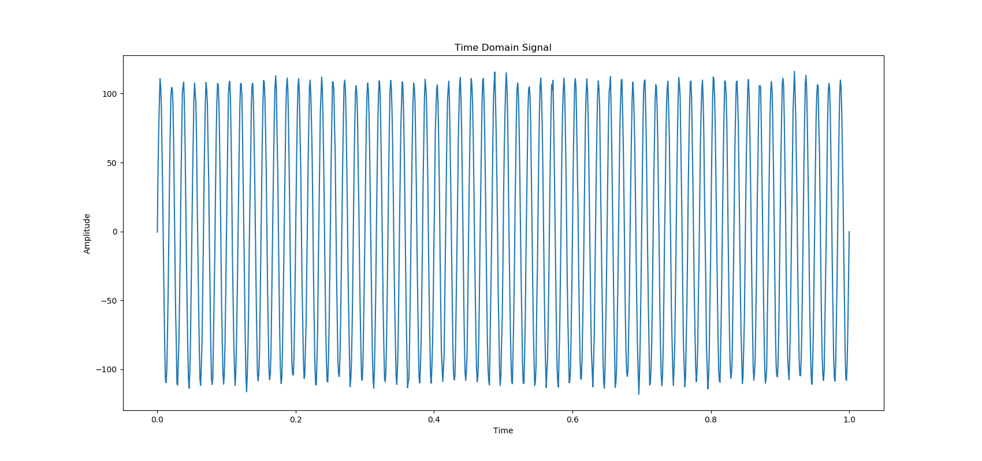
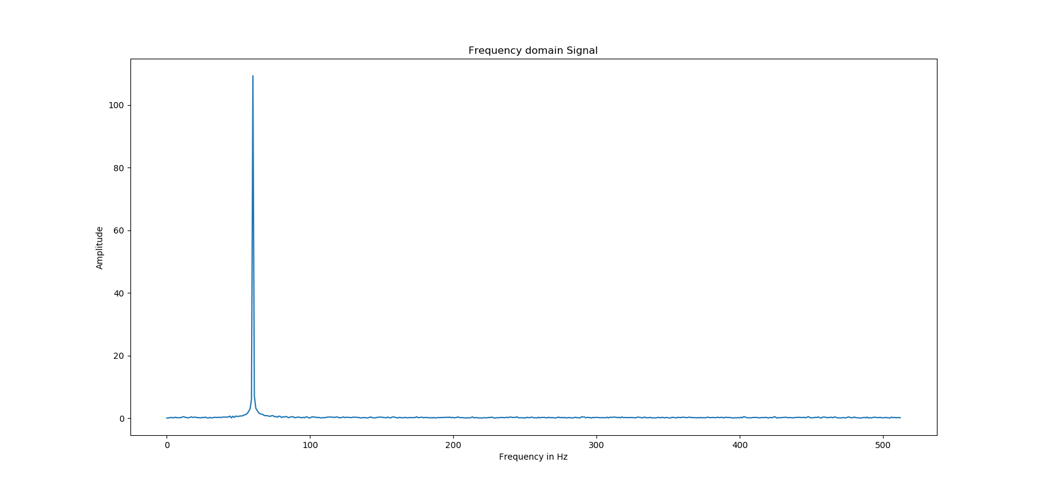
Intuition - Fourier

Slide 31
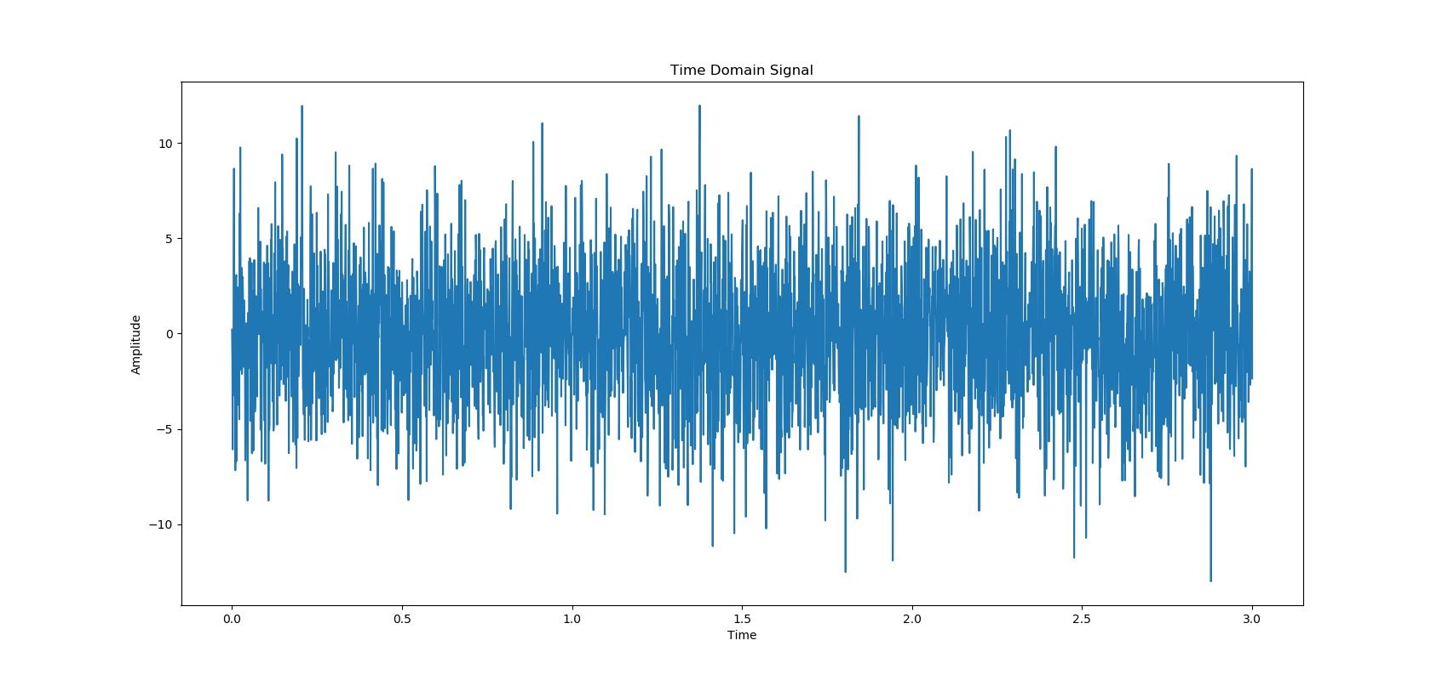
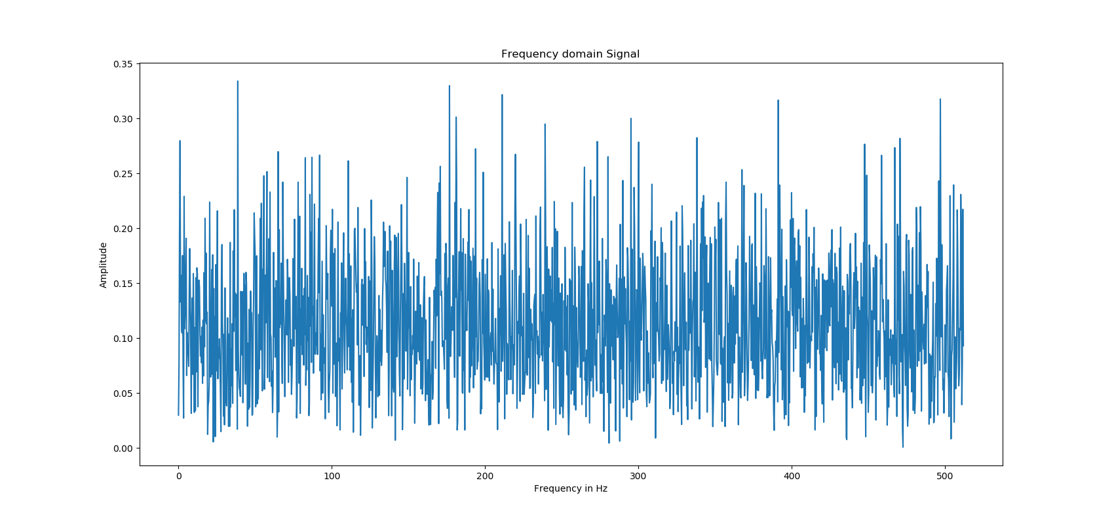
Intuition – Random Signal

Slide 32
Computation vs Accuracy
Malware
Process 1
.
.
.
Process N
C&C Server
Either repeat the analysis for each destination (Expensive), or do once for aggregate traffic (less accurate)
Two Issues:
Number of benign destinations
Traffic volume (Control traffic is in general smaller than data traffic
Dest 1
Dest N

Slide 33
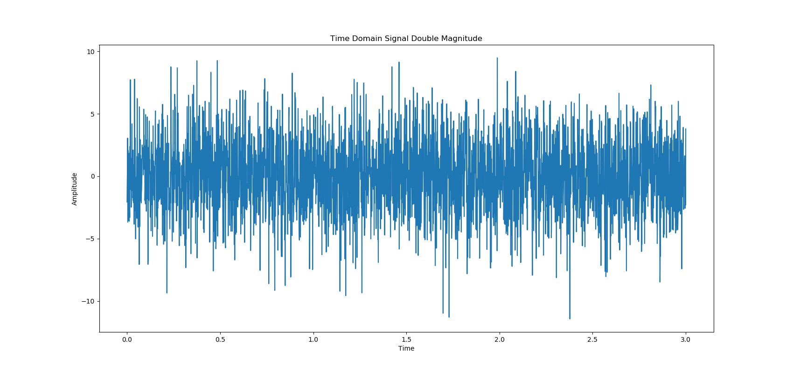
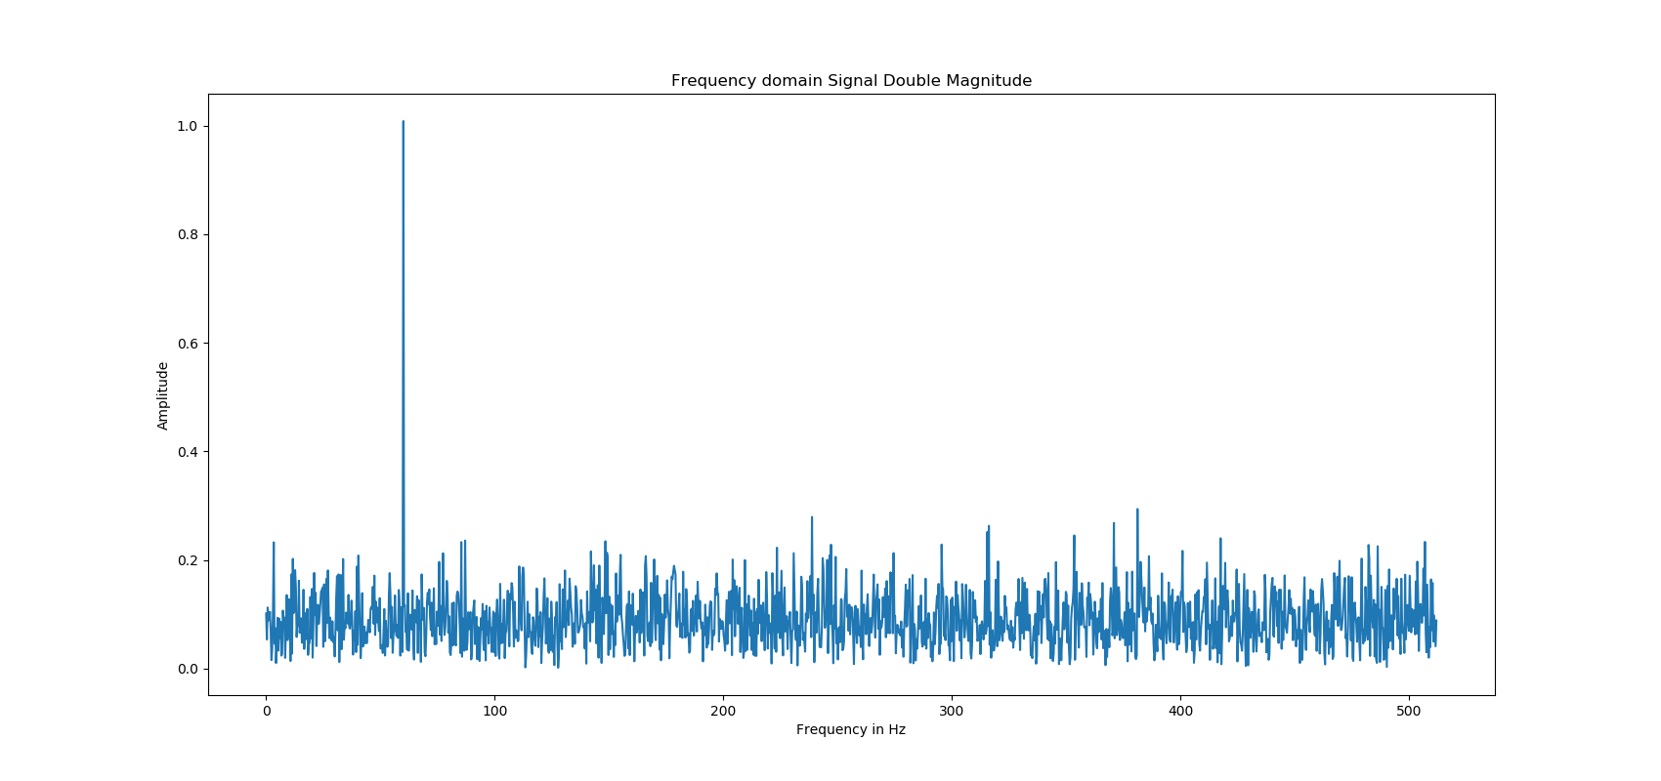
Equalization (Major traffic contribution from Malware)

Slide 34
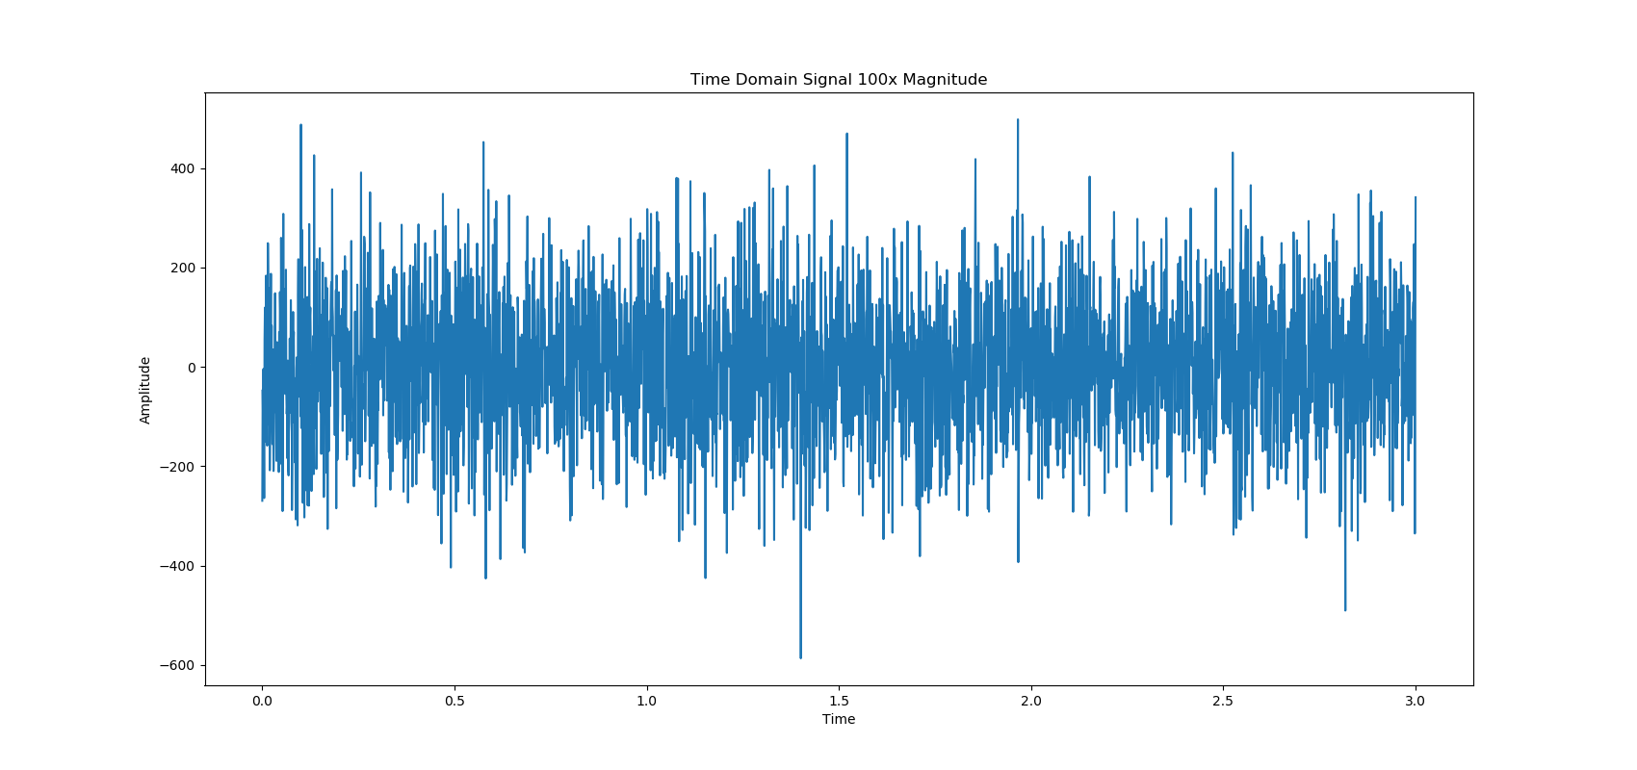
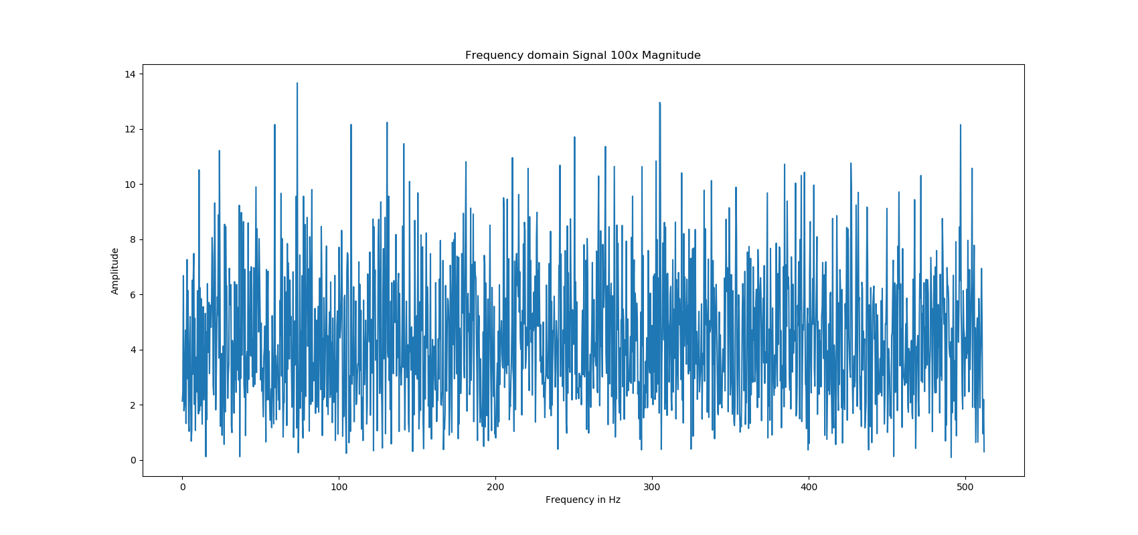
Equalization (Minor traffic contribution from Malware)

Slide 35
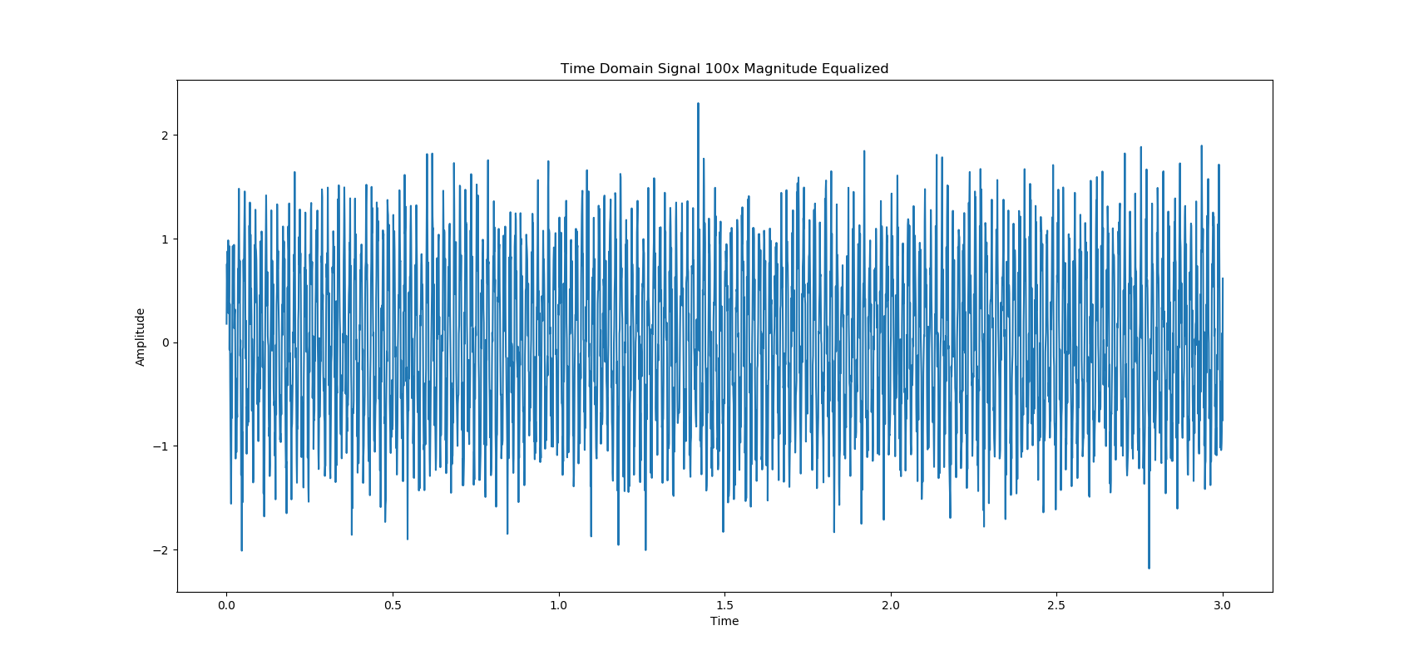
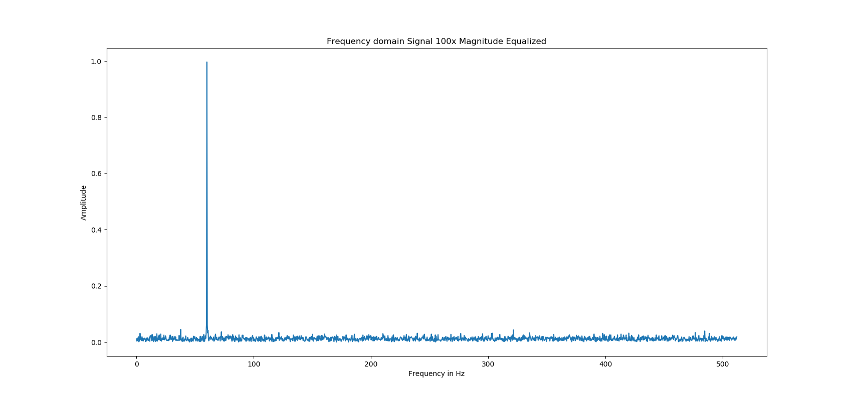
Equalization (Minor traffic contribution from Malware - Equalized)

Slide 36
How to detect
Mathematically test for periodicity
Cannot set manual thresholds
Walker’s Large Sample Test

Slide 37
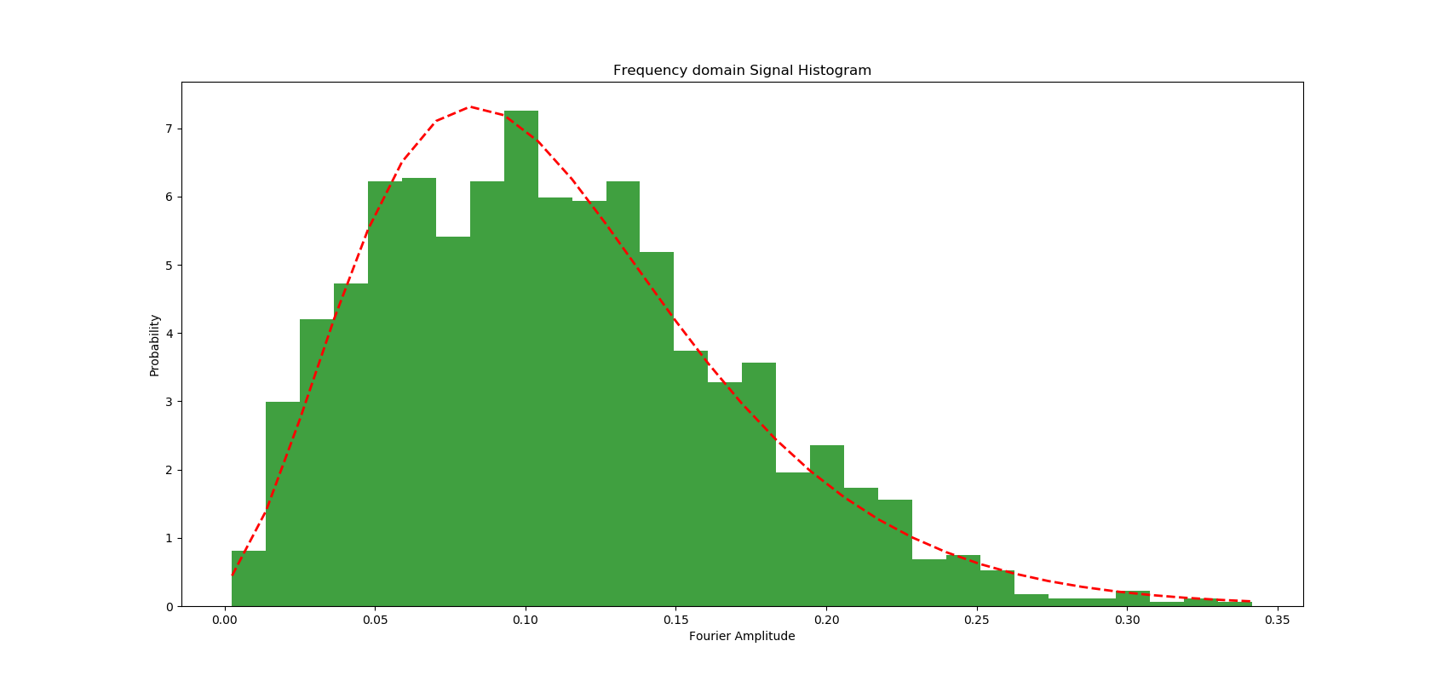
Noisy Signal (Chi-Square Fourier Amplitude)

Slide 38
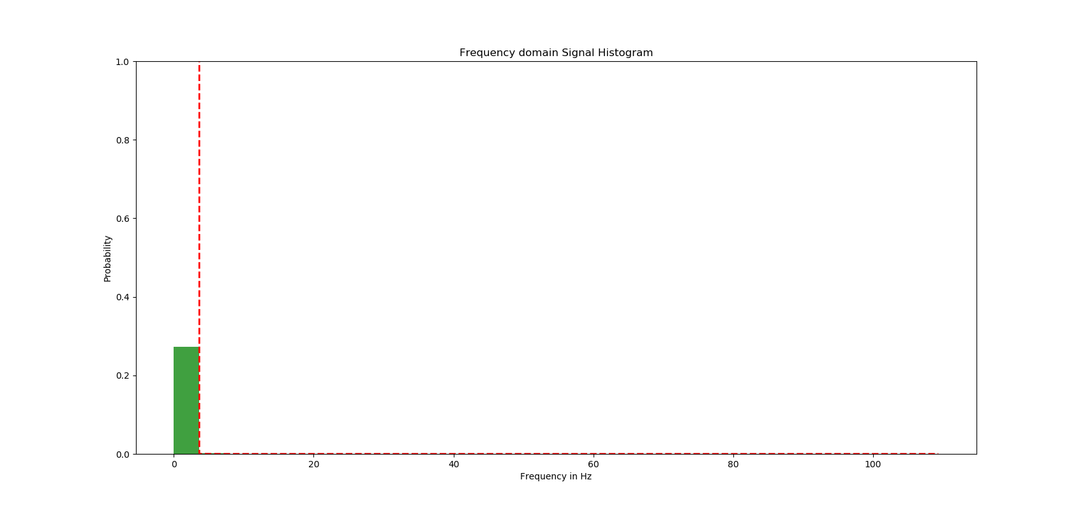
Periodic Signal

Slide 39
Enhancement
False Positives from signals that are not Periodic
Example – Spiky Traffic

Slide 40
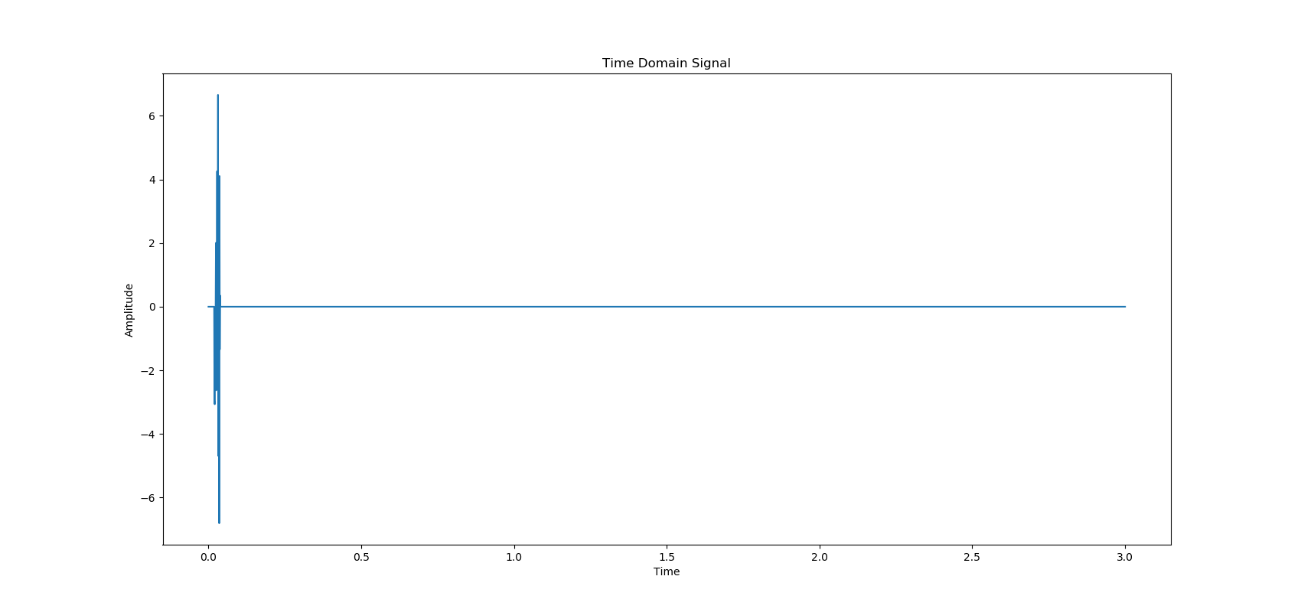
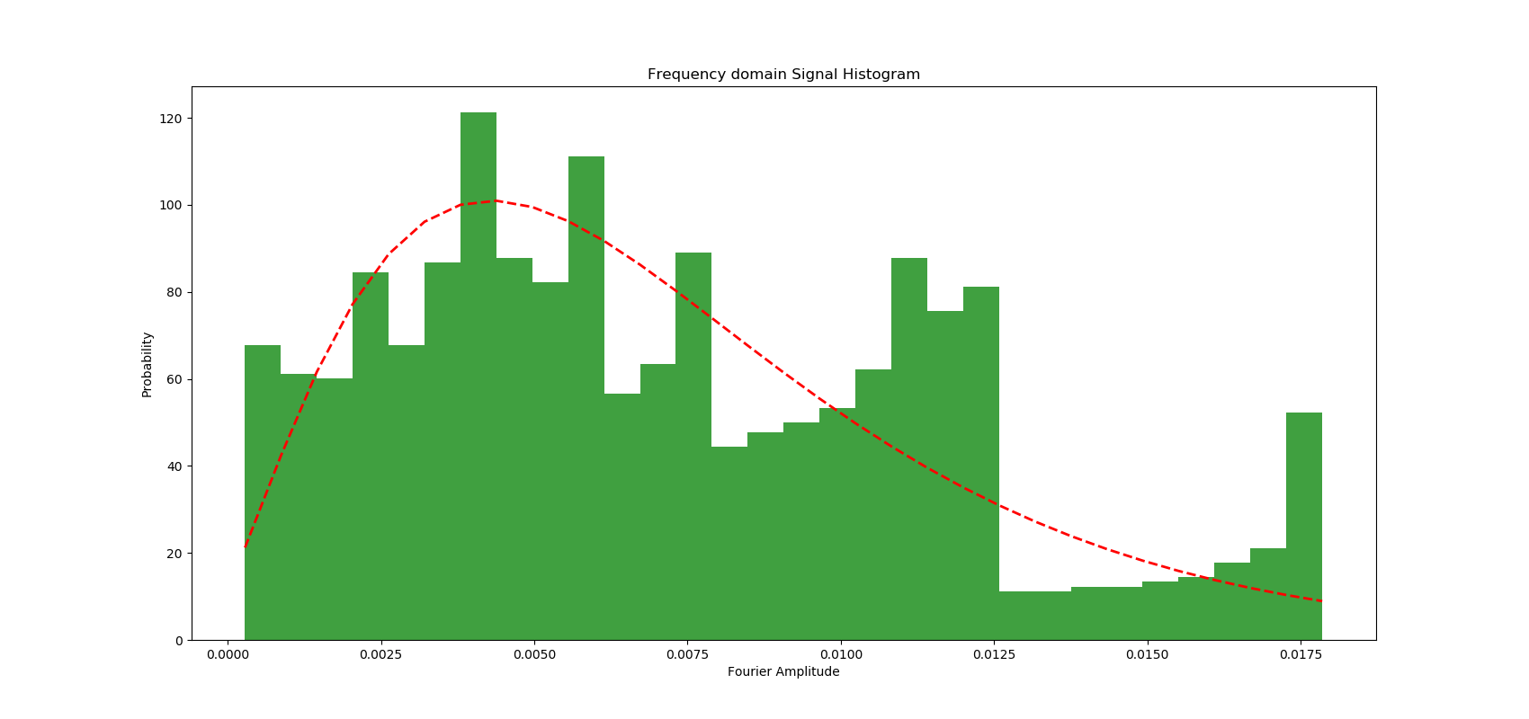
Pulse Signal

Slide 41
Auto Correlation Function
Correlation of a signal with a delayed copy of itself

Slide 42
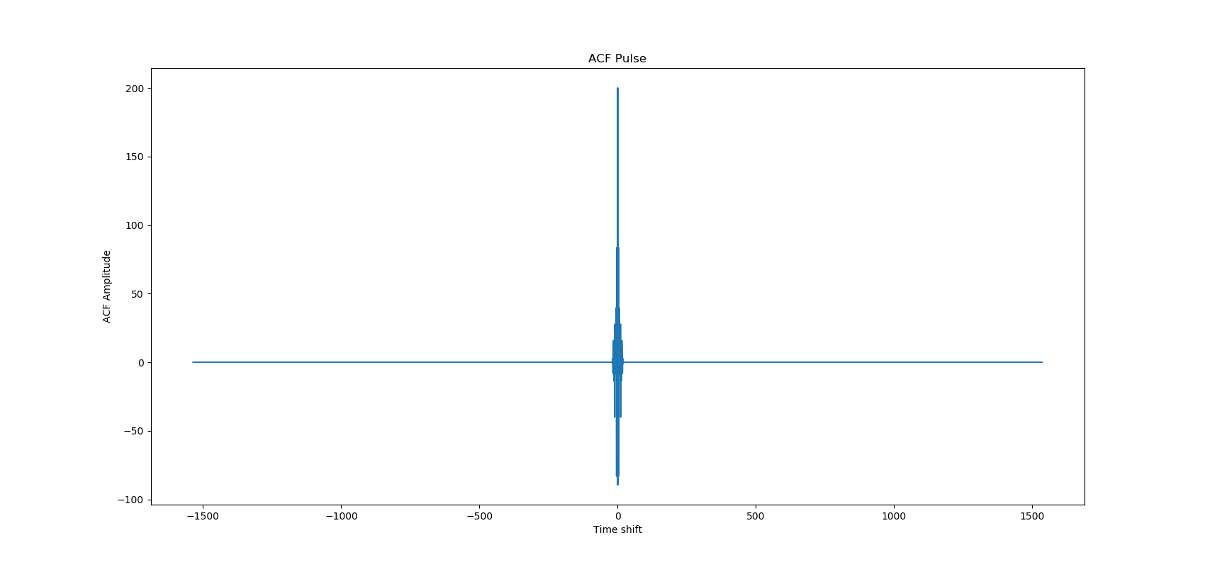
Pulse Signal - ACF

Slide 43
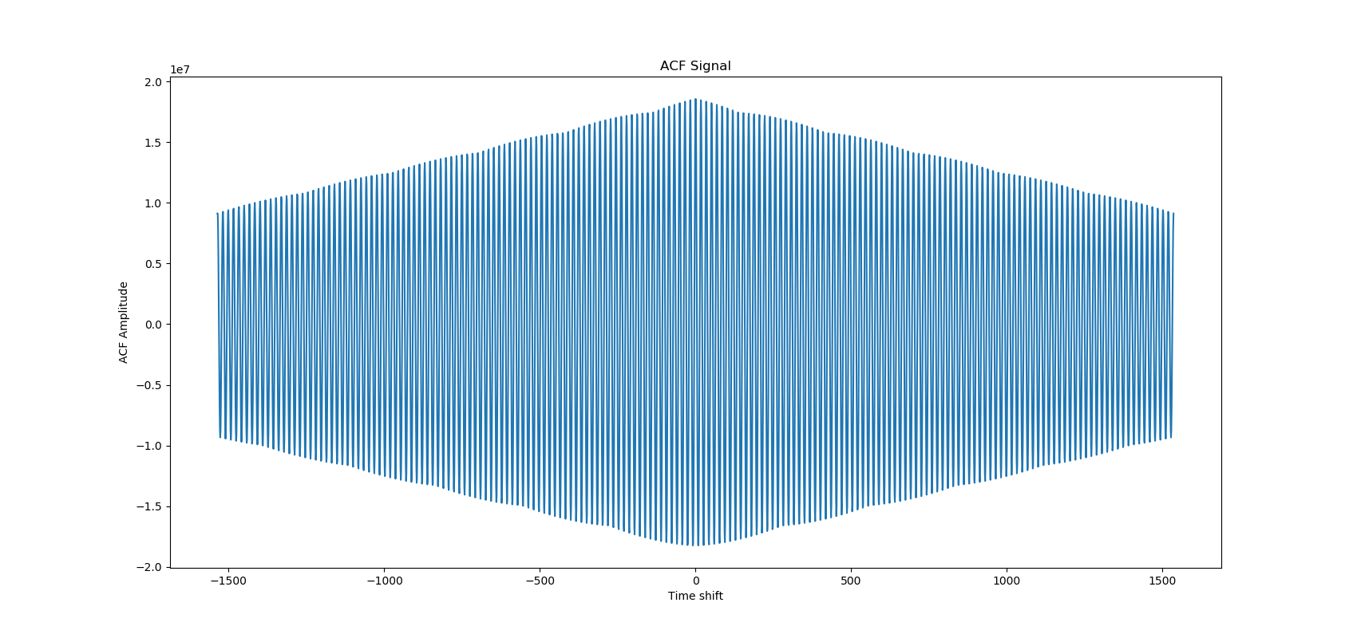
Periodic Signal - ACF

Slide 44
Periodicity Detection
(Filter)
Select maximum frequencies
And check the ACF
FFT
Hypothesis Test
Explain the anomaly

Slide 45
Explainability and Future Work
Explain:
  A: what is the period
  B: what is destination
  C: when did it happen
Fourier can’t tell when a periodic behavior happened (no temporal localization)
Wavelet Transform !

Slide 46
Root-Cause and Incident Detection

Slide 47
Incident Detection and Factor Graphs
Incident: a group of alerts corresponding to the same underlying attack and covering different phases of the kill-chain.
For example, a reconnaissance, followed by lateral movement followed by data exfilteration is a valid incident, but the opposite order is not true.
Another way: anomalies are like symptoms, given the symptoms identify the true cause, the attack.
Factor Graph: a probabilistic graphical model, successful in LDPC decoding, medical diagnosis and windows troubleshooting.

Slide 48
Factor Graphs - Representation
Variable nodes
Factor Nodes

Slide 49
Factor Graphs – Inference (Sum-Product Message Passing)
0.8, 0.1, 0.2, 0.7, 0.3, 1.2, 0.4
I believe there is a 80% chance you are 0
I believe there is a 90% chance you are 0

Slide 50
Factor Graphs – Inference (Sum-Product Message Passing)
0.8, 0.1, 0.2, 0.7, 0.3, 1.2, 0.4
I believe there is a 80% chance I am 0
I believe there is a 90% chance I am 0

Slide 51
Factor Graphs – Inference (Sum-Product Message Passing)
0.8, 0.1, 0.2, 0.7, 0.3, 1.2, 0.4
x₀ | x₁ | x₂
0 | 0 | 0
0 | 0 | 1
0 | 1 | 0
0 | 1 | 1
1 | 0 | 0
1 | 0 | 1
1 | 1 | 0
1 | 1 | 1

Slide 52
Factor Graphs – Inference (Sum-Product Message Passing)
0.8, 0.1, 0.2, 0.7, 0.3, 1.2, 0.4
x₀ | x₁ | x₂
0 (0.8*0.9) | 0 (0.9) | 0 (0.8)
0 | 0 | 1
0 | 1 | 0
0 (0.2*0.1) | 1 (0.1) | 1 (0.2)
1 | 0 | 0
1 (0.9*0.2) | 0 (0.9) | 1 (0.2)
1 (0.1*0.8) | 1 (0.1) | 0 (0.8)
1 | 1 | 1
Product
Sum

Slide 53
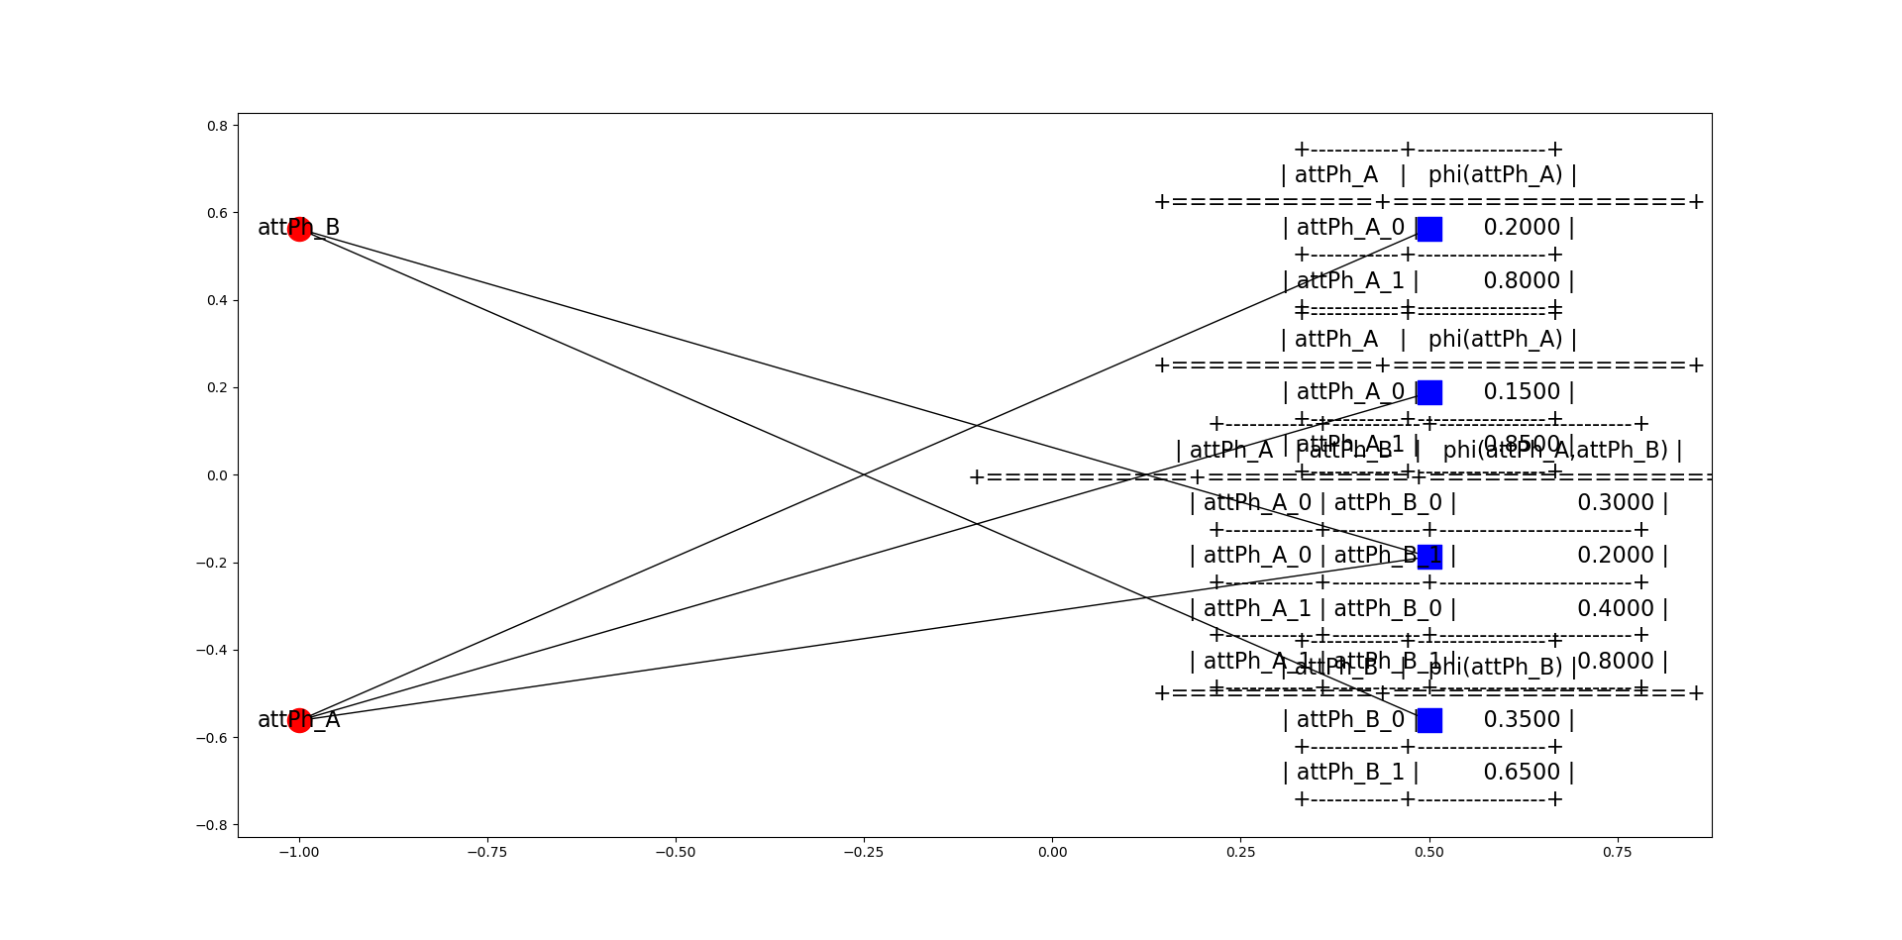
Incident Scoring
Factor nodes representing observations
= Alerts with scores
Factor Nodes representing Code Design
= Transition matrix, probabilities

Slide 54
Incident Scoring
Alert x is indicating there is an 80% chance Phase A is active
We know that Phase A is very likely to be followed by Phase B

Slide 55
Learnable Factors
Score of alerts
Cao, “On Preempting Advanced Persistent Threats Using
Probabilistic Graphical Models”
Needs a dataset of attacks, extremely rare
Causality of 2 alerts

Slide 56
User Interaction and Active Learning

Slide 57
Active-Learning and IP2Vec
Azure
AWS
Enterprise migrates to a new cloud
Suddenly, lots of traffic to new IPs, looks like data exfilteration
Potentially hundreds or even thousands of alerts
Analyst needs to whitelist them
Enterprise

Slide 58
Alert Similarity
Alert A
Alert Similarity determined their attributes
How do you measure similarity between 2 IPs ?
IP
Alert B
IP

Slide 59
IP Similarity
Manually designed
Need new tree for each kind of attribute, e.g. prt, protocol, … etc
Solution: IP2Vec

Slide 60
IP2Vec
Very similar to word2vec
Train a NN to get a vector representation for categorical network quantities
Easily extendible to IPs, Ports, protocols, … etc

Slide 61
Example of Microsoft IPs
Burr, Wang, Salmon, Soliman, “On the Detection of Persistent Attacks using Alert Graphs and Event Feature Embeddings”, GraSec 2020

Slide 62
Can do more
Identify server rule:
  For example, an analyst whitelists DNS server, embeddings knows port 53 is very related, so all DNS traffic can be whitelisted.
Different subnets:
  Visitor IPs subnet is different from the core machines subnet, subnets show as clusters in the embedding.
For easy experiments:
  Download any network logs dataset
  Feed to star-space https://github.com/facebookresearch/StarSpace

Slide 63
One step further: GAT
Beyond log data, Graph Attention Networks (GAT) can leverage the graph structure for better embeddings
  Inductive vs transductive: inductive approaches can embed unseen nodes, a feature we need for constantly changing networks "Inductive Representation Learning on Large Graphs".
  Edge attributes: edge information (protocol, byte count, ...) are as important as node attributes. "Exploiting Edge Features in Graph Neural Networks"
  Dynamic graphs: how the embeddings should handle the changes in the graph "DynGEM: Deep Embedding Method for Dynamic Graphs"
  Anomaly detection: maybe using auto-encoder based architectures to detect anomalous changes "Graph Attention Auto-Encoders"
Very good for alert correlation, but not good enough for alert causality.

Slide 64
Conclusion
More then anomaly detection:
  Explainability.
  root-cause.
  Incidents and Alert Correlation.
  Causality.
Probabilistic Graphical Models for incident detection knowing the typical attack structure
DL/NLP for categorical feature embedding, similarity measures.
Questions, ideas: hazem.soliman115@gmail.com

